Slide 1



Slide 2

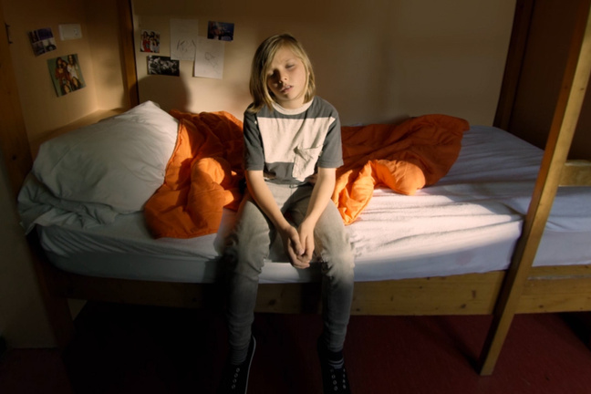
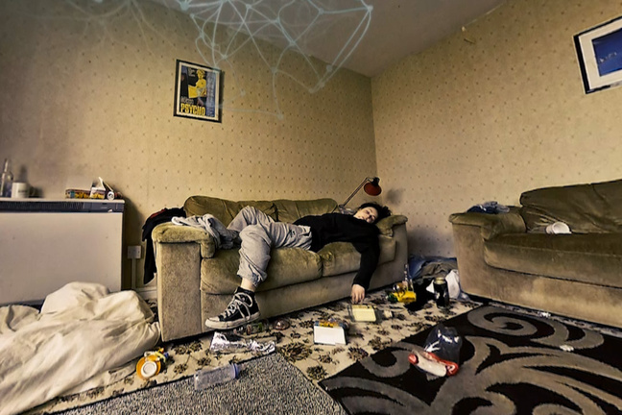
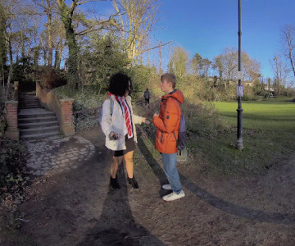
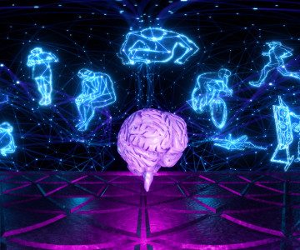
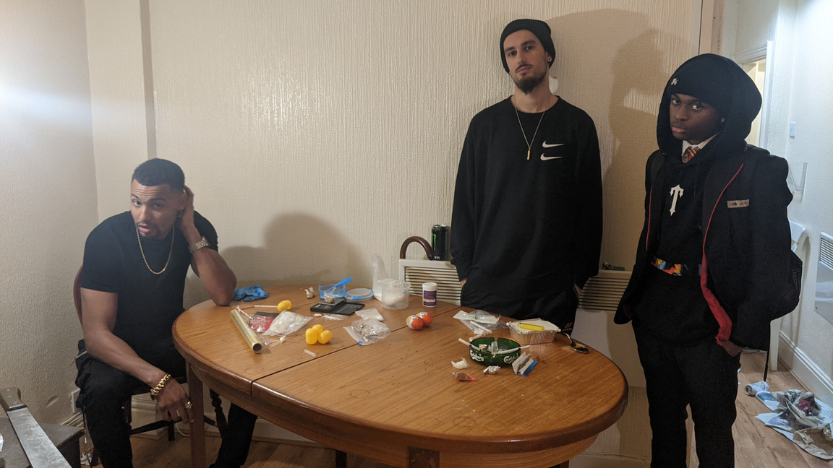

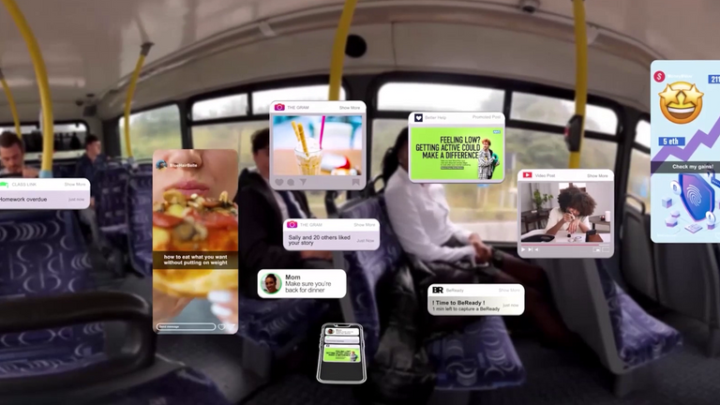
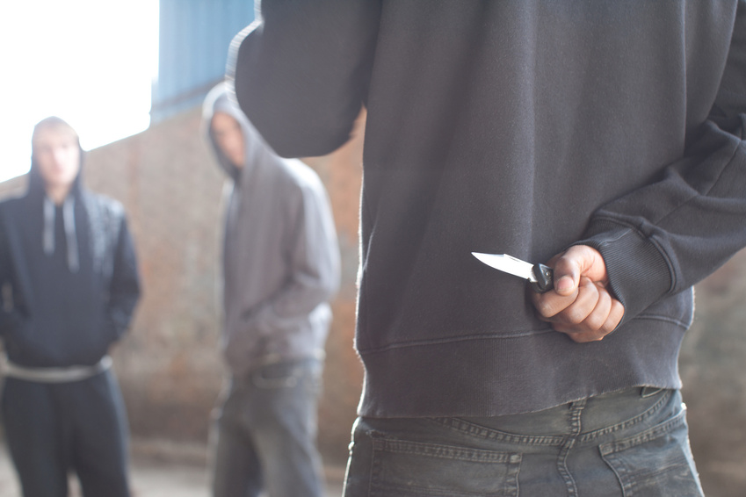
Our Journey
Fostering and Adoption
Early Life Trauma and PACE
Vulnerabilities in Adolescence
The Adolescent Brain
2017
2018
2020
2021
Fetal Alcohol Spectrum Disorder Awareness
Social Media and
Digital Platforms
Serious Youth Violence/
Knife Crime
2023
2024
Notes:
We’ve been developing VR 360 immersive films since 2017 where you see the world as the child see’s it.
The aim of our programme is to increase awareness and understanding of children and young peoples life experiences from in the womb through to adolescence, increasing empathy towards them to support a positive shift in behaviour.
The films have been developed with professionals, and later with young people.
We have evolved and grown with our partners and societies developing needs.
The aim today is to immerse you into our young peoples world as they see it, allowing you a safe reflective space after to think how you can make a difference to the challenges they face.

Slide 3
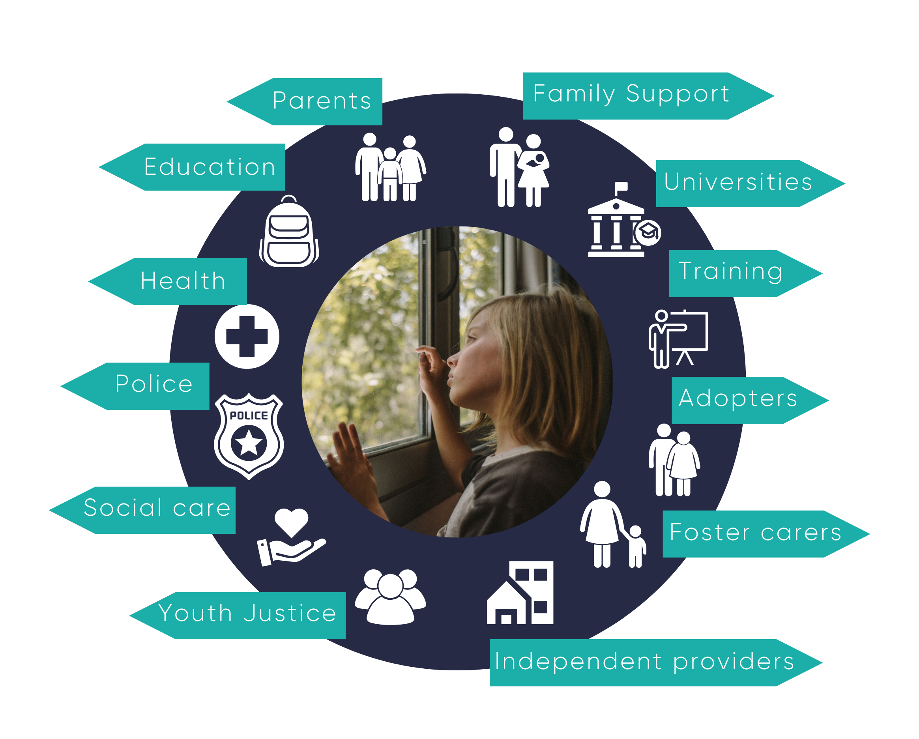

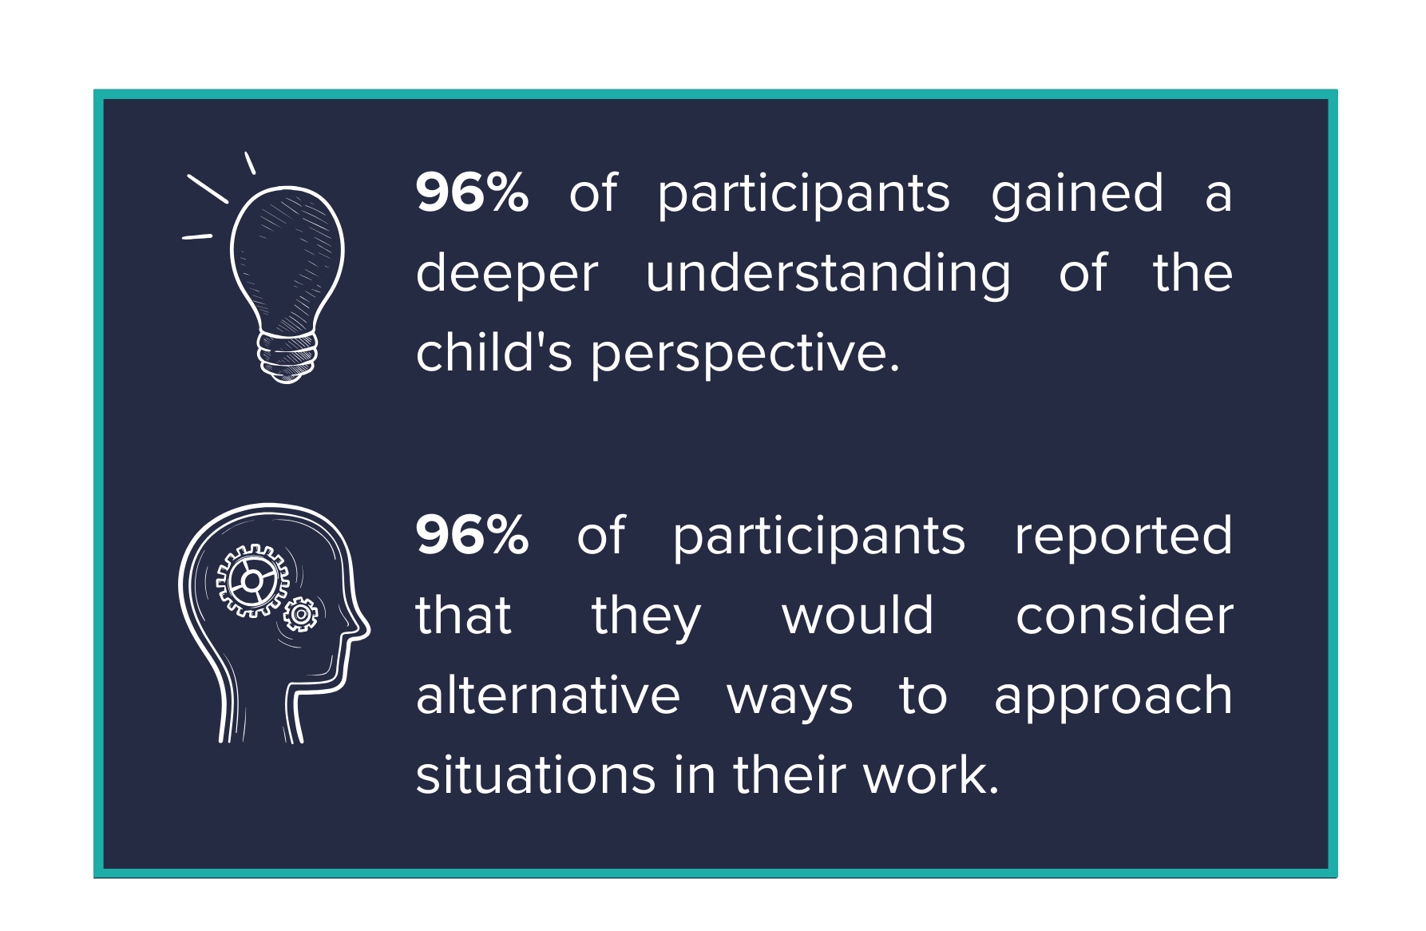
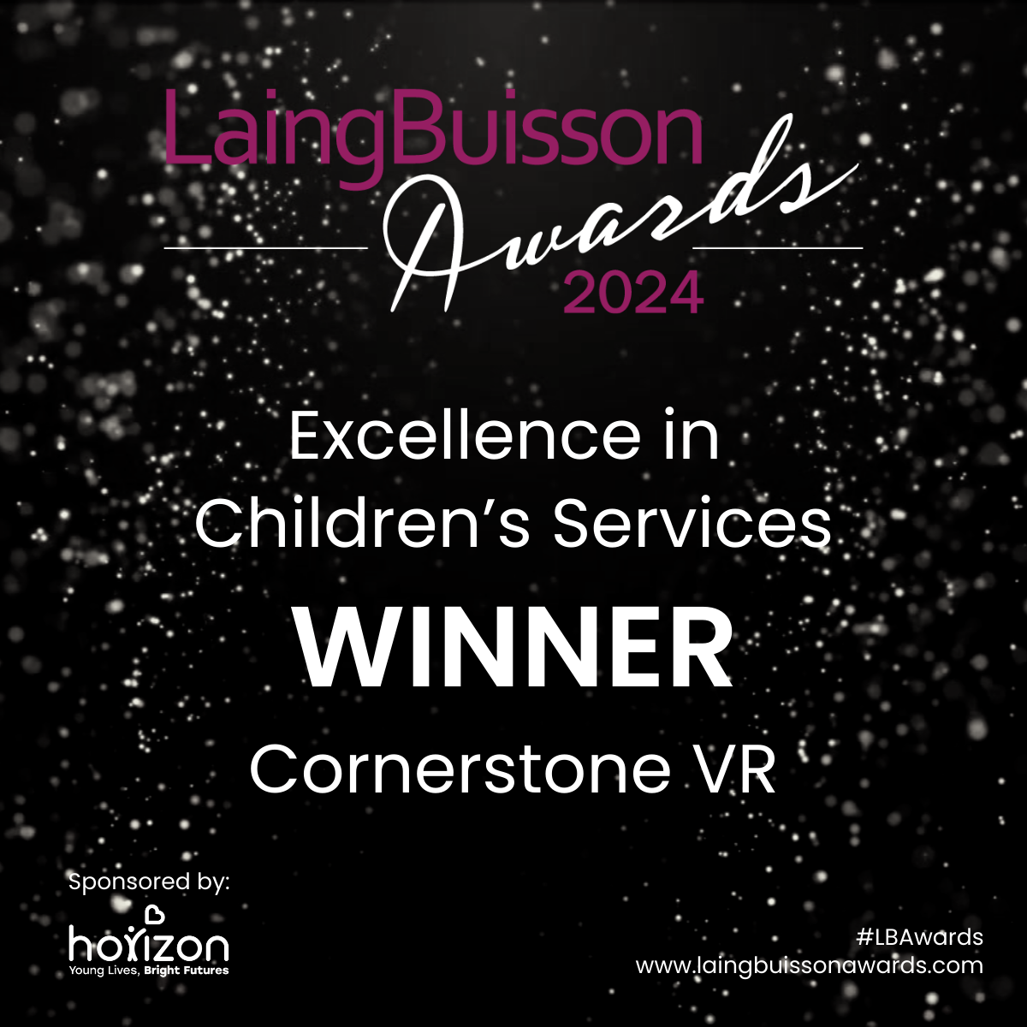
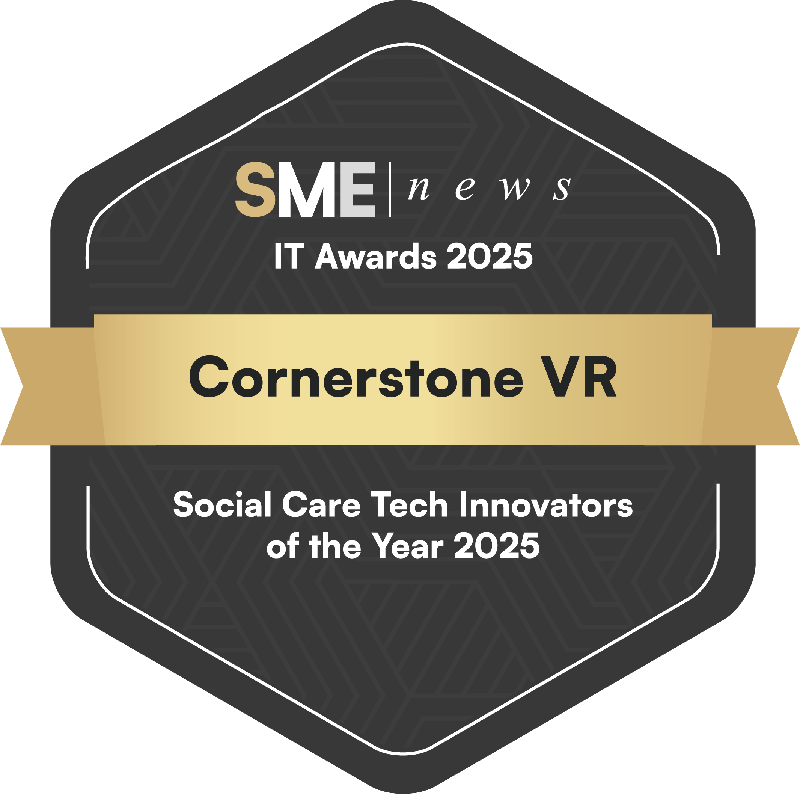




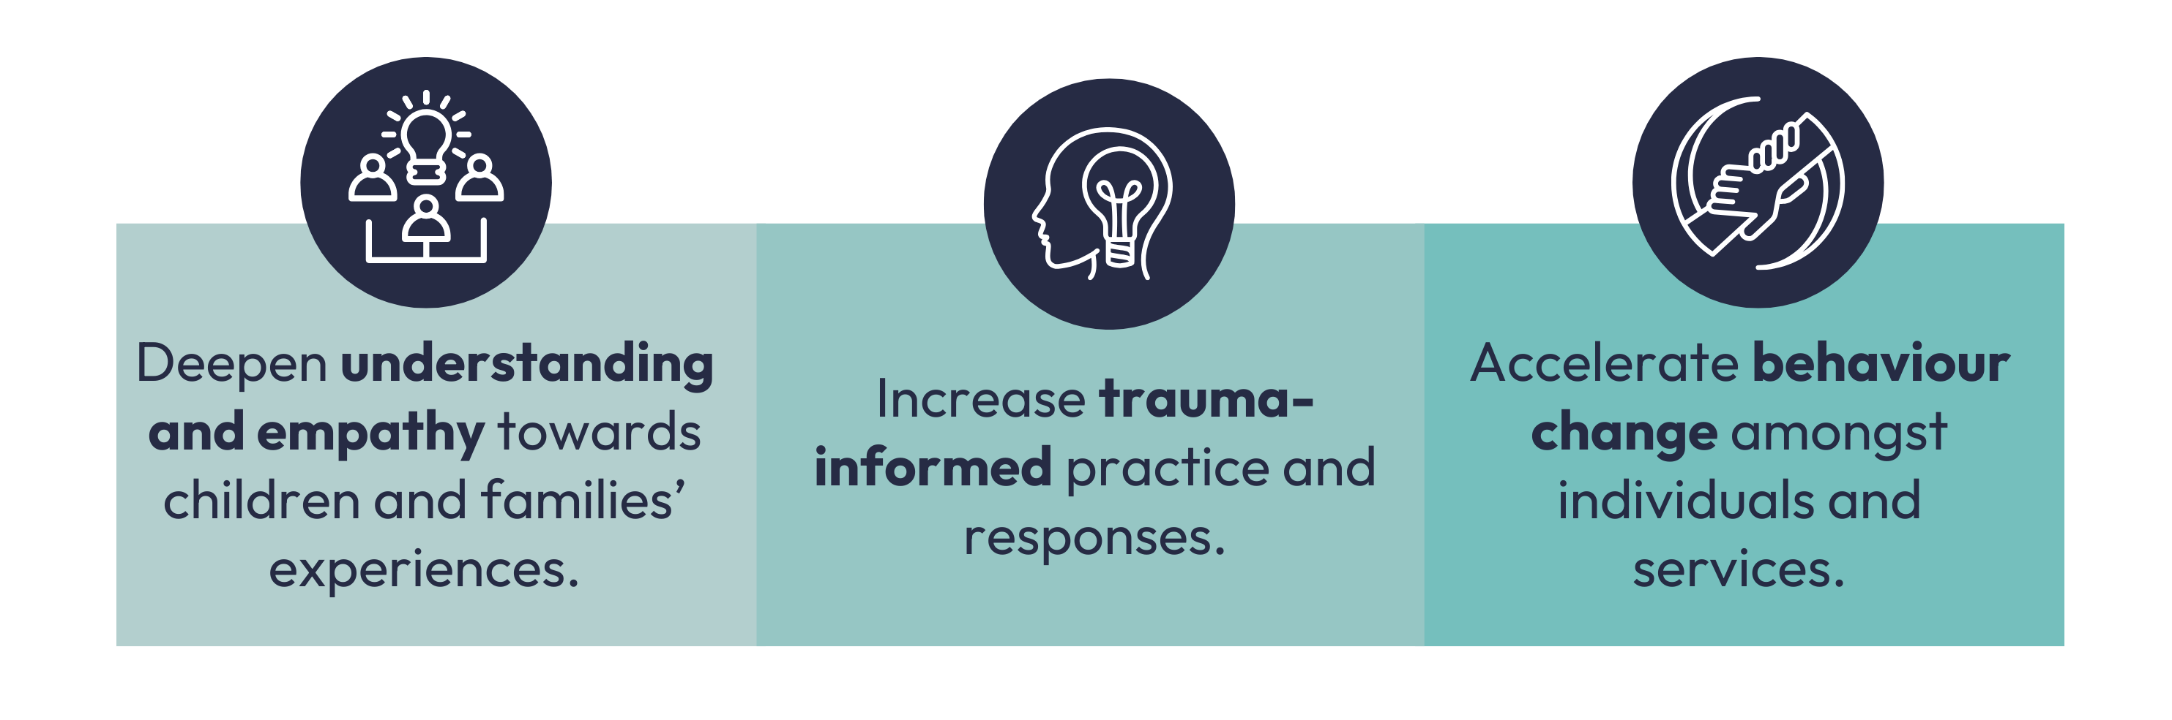
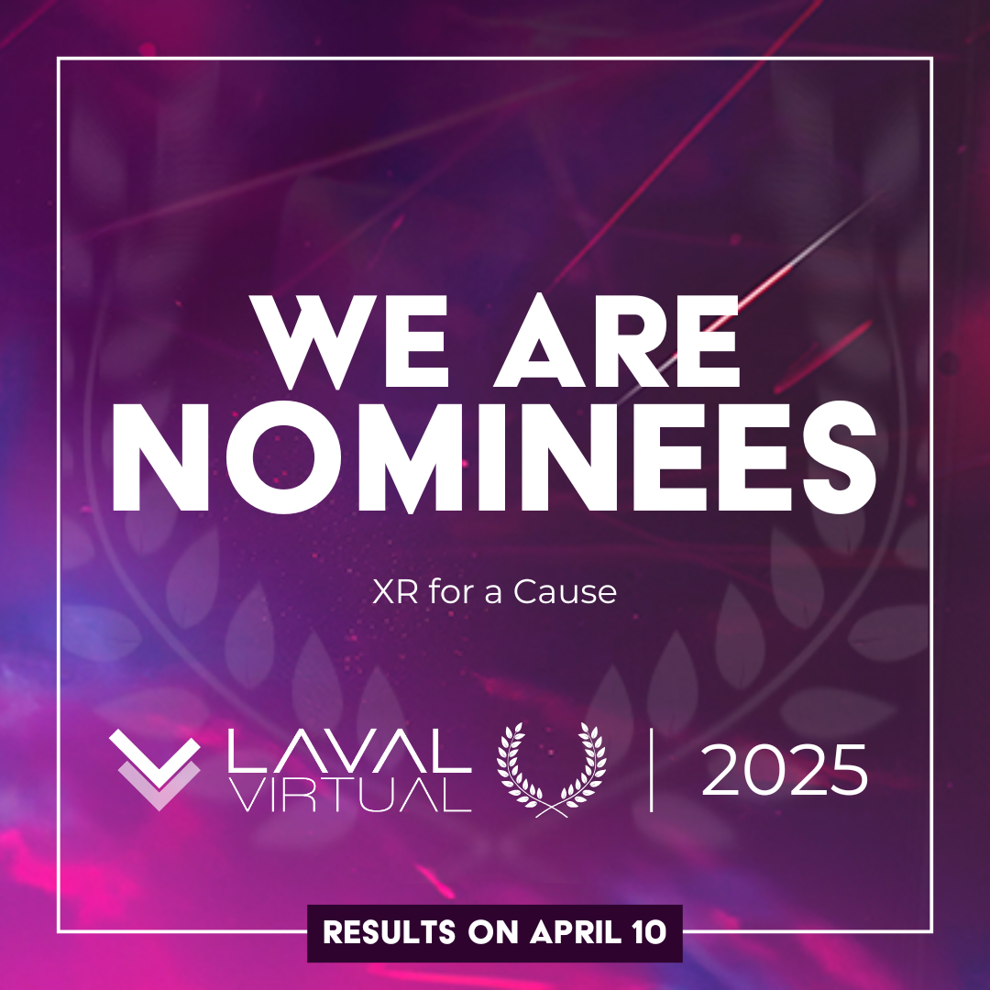




Questions and answers
“Genuinely innovative and groundbreaking, offering a truly unique therapeutic approach that has the potential to make a real difference for some of our most vulnerable young people.” -LaingBuisson Awards
Notes:
Why VR:
“You never really understand a person until you consider things from his point of view - until you climb into his skin and walk around in it.”
- Harper Lee
The PwC report “Seeing is Believing” (2021) found that compared to traditional learners, VR learners are:
4x more focused;
4x faster learners;
275% more confident.
Our programme is being used across all the above sectors with partners reporting significant changes including:
Systemic shift across organisations
Reviewed policies to be trauma informed and responsive
Reduction in exclusions
Reductions in young people going missing
Increased placement stability in families that were at crisis point
Increased participation of young people in activities such as youth groups, key worker sessions
Increased sense of belonging in education and at home

Slide 4
Processing the VR experience
And preparing yourself/others for viewing
Individual learning styles mean that viewers will react differently. Some people may have an immediate reaction, whereas others may have a delayed reaction.
Seek advice from a relevant health practitioner (e.g. a GP) if you are concerned about VR interfering with a health condition.
Do not stand up whilst wearing the headset.
Loosen your headset straps if they feel tight.
Keep headsets away from sunlight and do not use outside.
Notes:
HEALTH WARNING Trainer this is an AN EXCEPTIONALLY IMPORTANT SLIDE Please read notes below to learners.
Emphasise the importance of using the VR in an ethical manner, recognising the potential for some people to be triggered by the content. We need to consider this when we are using these immersive tools.
As individuals and as an organisation they have a duty of care as to how they will support individuals in using the content.
We don’t know each others pasts, triggers and how these films will affect everyone.
Really important that we use our risk assessment skills when considering if the VR suitable to be shown to this person, with the information I have about them - as it isn’t suitable for everyone.
What needs to put in place to minimise any adverse reactions?
Ensure you are clear about why you are showing the content
Explain to the person/group why you are showing it
Give a brief explanation of what they are about to watch
Ensure they are sitting down
Give permission to stop viewing the VR at any time
Allow enough time for a debrief/discussion after showing the VR
Check in at a later time/day if appropriate to ensure they are OK – or signpost them to someone they can talk to
It is your responsibility to use the VR responsibly and with a duty of care
The Elephant film is a good one to use as the first film to help the experience VR with something easy to view.

Slide 5
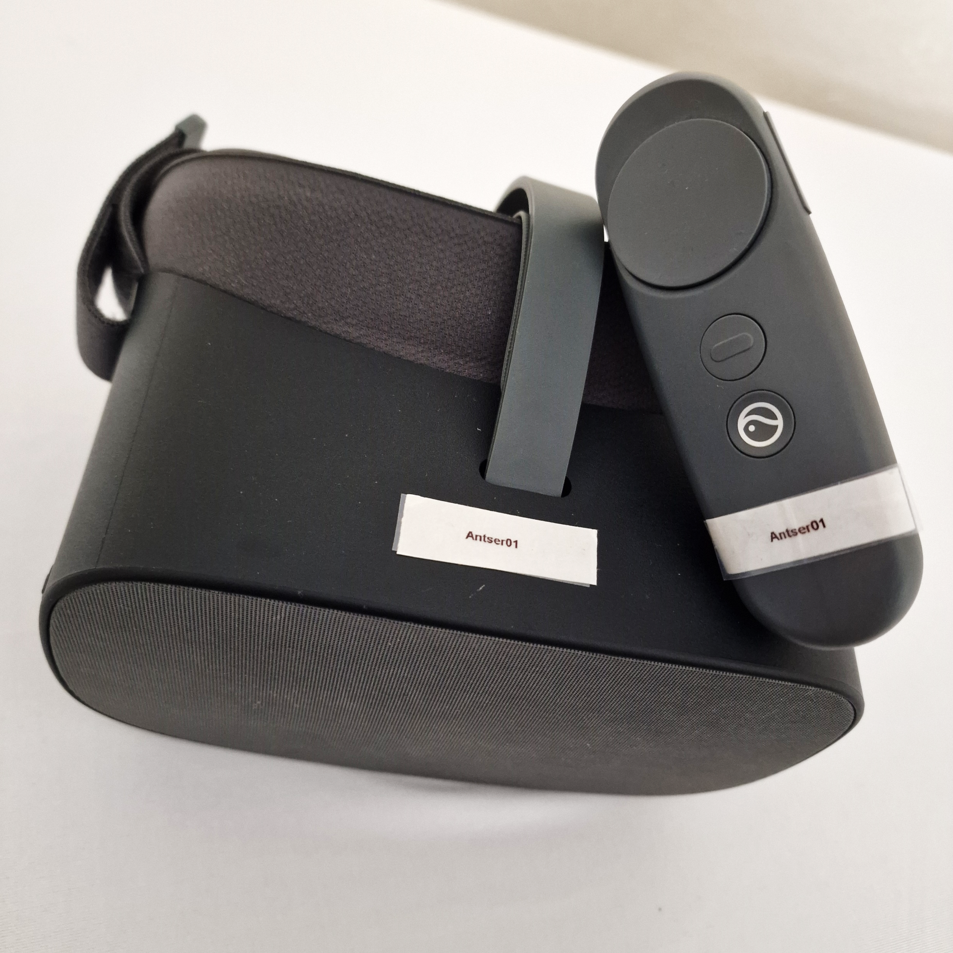
Logging into the headsets
Online Mode vs Offline Mode
The Offline Mode pin is 6417.
Online Mode logins correspond with your headset/controller’s name:
Username: name of headset/controller
Password: name of headset/controller with ‘!’ at the end
…for example:
Username: Cornerstone01
Password: Cornerstone01!
Usually only the first letter in the password if upper case.
Notes:
THIS WILL BE THE STARTING POINT FOR INTRODUCING THE HEADSET, AND WALKING THEM THROUGH HOW TO USE.
YOU CAN REFER TO THE HEADSET GUIDES ON THE PORTAL SHOULD YOU COME INTO ANY DIFFICULTIES.

Slide 6
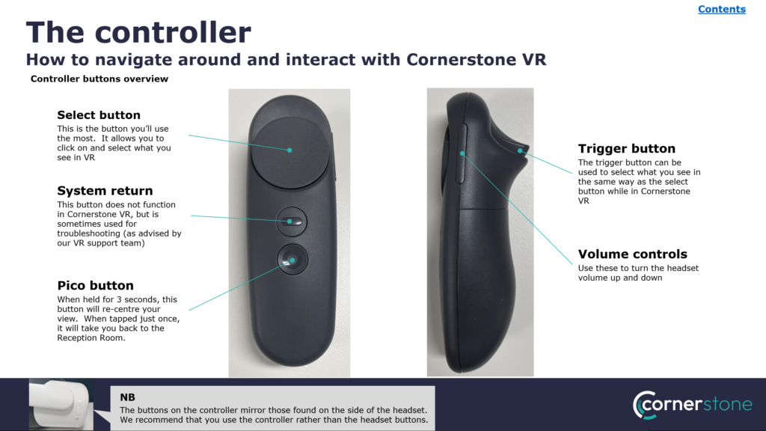
Notes:
GO THROUGH CONTROLLER- NOTE THE TRIGGER BUTTON WORKS ON THE G3 HEADSETS BUT NOT ON THE G2 (THIS WILL BE IMPORTANT TO RECOGNISE IN ONLINE CERT COURSE AS PARTICIPANTS MAY BE USING BOTH)
ONCE YOU HAVE GONE THROUGH THE CONTROLLER AND THE VR HEADSET BUTTONS TAKE PEOPLE INTO THE HEADSET.
OFFLINE- 6417
SHOWING ANY CONTENT INCLUDING ELEPHANTS NEEDS AN OVERVIEW OF WHAT THE PARTICIPANT IS GOING TO EXPERIENCE- GIVING HEALTH WARNINGS- HIGHLIGHTING THAT YOU NEVER KNOW ANYONES TRIGGERS- WE ONCE HAD SOMEONE SHARE THAT THEY COULDN’T WATCH THE ELEPHANTS BECAUSE THEY’D SEEN SOMEONE BEING TRAMPLED. YOU NEVER KNOW ANYONES EXPERIENCES, WHICH IS AN IMPORTANT POINT AND ONE WE SHOULD REMEMBER THROUGHOUT THE DAY. REMINDERS AROUND REMOVING HEADSET IF THEY WANT TO, STAY SEATED ETC.
TOP TIP: For session delivery get your headsets turned on prior to the session and get them set up into the room you are going to use with films in front of you.

Slide 7

Equality, Diversity and Inclusion
Our training values
There is a shared responsibility (trainer and delegates) to address issues of equality, diversity and inclusion.
Always consider issues of age, class, culture, disability, gender, race, sex, sexual orientation, religion.
Follow an intersectional approach, considering the multiple aspects of a person’s identity and how these can impact one another.
Challenge yourself to consider other perspectives to avoid stereotyping and assumptions.
Notes:
INTERSECTIONAL APPROACH refers to an approach to inclusion that considers the multiple aspects of a person’s identity and how these can impact on one another. For example, intersectional feminism recognises that black women, disabled women and LGBTQ+ women may have gender in common, but their lives will likely be different due to race, disability, and orientation. In turn, it also acknowledges that a black, disabled, LGBTQ+ woman will face unique barriers because of her multiple identities.
Equality
Equality means making sure that everyone is treated fairly and with dignity and respect. It means challenging discrimination and removing barriers, so that everyone has opportunities to achieve their desired outcomes.
Diversity
Diversity is about recognising the benefits of different values, abilities, and perspectives, and celebrating people’s differences. This means promoting an environment that welcomes and values diverse backgrounds, thinking, skills and experience.
Inclusion
Inclusion is providing a space where everyone has equal access to opportunities and resources, and where everyone feels valued and accepted. Everyone should be able to contribute and have a voice. This may mean making reasonable adjustments to facilitate participation. Definitions taken from Social Work England site April 23 https://www.socialworkengland.org.uk/
Think about how this can relate to VR experiences- Inclusivity, start conversations about how some participants may not be able to access VR, people who are hard of hearing. Discuss ways of supporting inclusivity, for example one partner supported a participant who wore hearing aids by meeting with them on a 1:1 whereby they didn’t use headphones. When it came to the workshop the participant described feeling part of the group.
This is a great space to start ongoing conversations around the headset, getting familiar with the settings. Some participants struggle with light sensitivity. If you double click on the pico button and go into ‘settings’ and then ‘display’ you have options to change the brightness.

Slide 8
Evaluation
Results
Baseline data – eg comparing past and current data. Comparing data in parallel between two similar teams/areas.
Baseline surveys – eg Sense of belonging from young people prior to VR use and after 3 months
Case studies – examples of where VR impacted a situation/engagement
Management review/audit of services
Learning
Participant pre & post feedback forms after training sessions.
Management review
Pre & post participant feedback forms after training sessions
Behaviour
Value of training
Baseline surveys – eg empathy/confidence of staff prior to VR use and after 3 months
Supervision
Notes:
Capturing impact is so important for all, please see our example using the Kirkpatrick Model and use in your groups to capture how this is going to look in your organisation.

